Slide 1
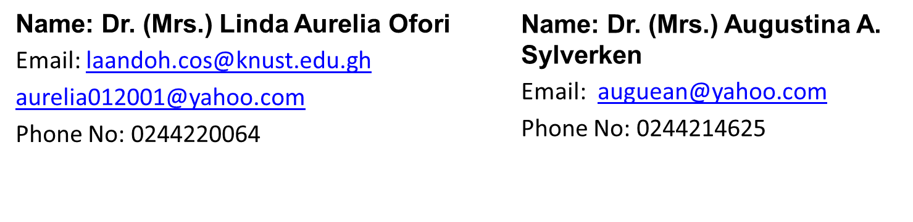
BIOL 252: MICROBIAL ECOLOGY 2019/2020

Slide 2
WASTEWATER TREATMENT

Slide 3
Where does it all go!
Where does the water from the washer go?
When you flush the toilet where does the contents go?
By gravity flow, the waste is on its way to your local wastewater treatment plant!

Slide 4
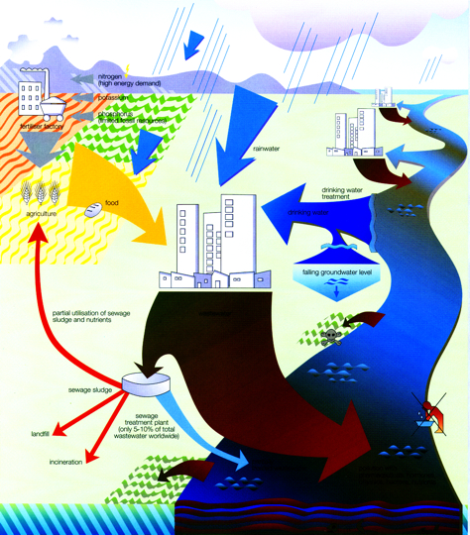
90% of the worlds wastewater does not receive any treatment
NORWEGIAN UNIVERSITY OF LIFE SCIENCES
(Corcoran et al. 2010)
4

Slide 5
WASTEWATER TREATMENT
Applies knowledge and technology to improve or upgrade the quality of wastewater.
To reduce organic matter content of wastewater (i.e. reduction of BOD)
Removal/reduction of nutrients (N, P) to reduce pollution of receiving surface waters or groundwater if the effluents are applied onto land
Removal or inactivation of pathogenic microbes and parasites

Slide 6
Why treat wastewater?
Causes a demand for dissolved oxygen (lower DO levels of streams)
Adds nutrients (nitrate and phosphate) to cause excessive growth
Increases suspended solids or sediments in streams (turbidity increase)

Slide 7
Wastewater Treatment
Tertiary

Slide 8
Wastewater Treatment
Screening
Primary settlement
Sludge digestion
Secondary treatment activated sludge trickle
Sludge disposal to sea, land burial, incineration, composting
Tertiary treatment; chlorination, UV, ozone
Effluent disposal; river, sea, irrigation

Slide 9
Wastewater Treatment
Conventional Sewage Treatment
Processes
Primary Treatment
Mechanical process
Screening
Grinding
Grit Chamber (heavy particles - “grit”)
Sedimentation Tank/ settling tank (suspended solids - “sludge”)

Slide 10
Conventional Sewage Treatment
Processes
Secondary Treatment
Biological process
Uses bacteria to removed Oxygen demanding wastes (ODW) and lower BOD
Types
Trickling Filter
Activated Sludge

Slide 11
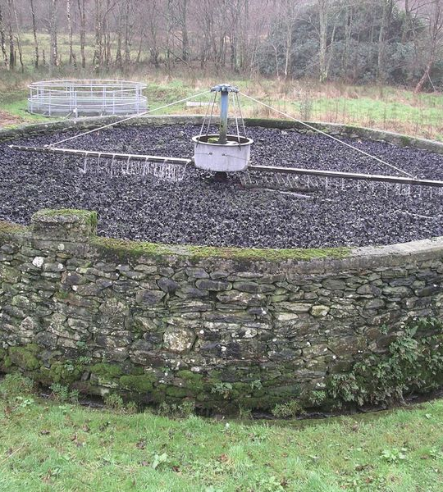
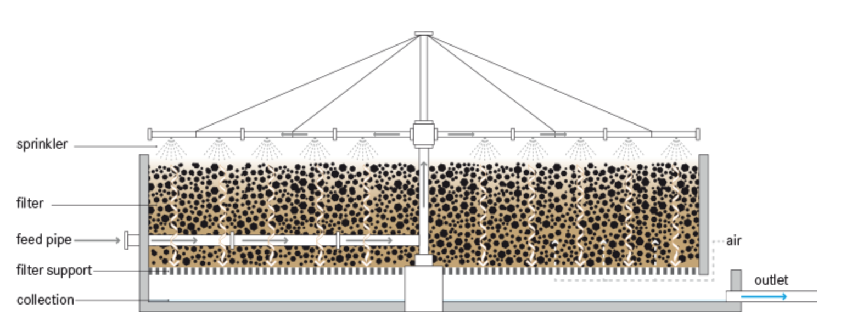
Trickling filter
Is a bed of crushed rocks or molded plastics about 2m thick
The bed must be large to allow air penetrate to the bottom and with a large surface area
Wastewater (effluent) is sprayed onto it
The effluent slowly passes through the bed

Slide 12
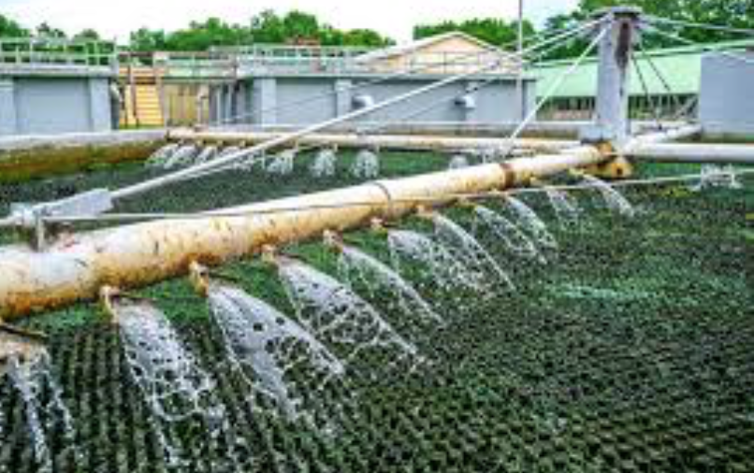
Biofilms in the effluent attach to the rocks and plastics
Bacteria in the biofilms extract and digest organic compounds (BOD) up to 80-85%
Protozoa and Rotifers are mainly responsible for removal of suspended solids

Slide 13
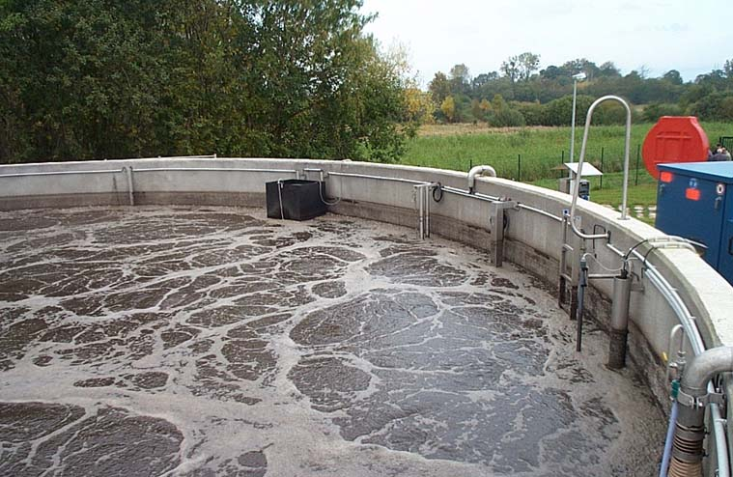
Activated sludge system
In the aeration tank, Air or pure oxygen is passed through the effluent
Here some sludge from the OLD batch is added to the NEW incoming sewage
This inoculum is called activated sludge as it contains large numbers of sewage-metabolizing microbes (Zoogloea bacteria)
These microbes oxidizes the organic matter in the effluent into carbon dioxide and water

Slide 14
Activated Sludge System
This produces bacteria containing masses called Floc or sludge granules
After 4 to 8 hrs the whole content is transferred to a settling tank where the floc settles out removing much of the organic matter
The solids are then treated in a sludge digester
The effluent is then discharged

Slide 15
Sludge digestion
Generated sludge are pumped into an anaerobic sludge digesters
Carried out in large tanks without oxygen thus encouraging growth of anaerobic bacteria especially the methane-producing bacteria
The bacteria degrades organic matter to soluble substances and gases mostly methane (60-70%) and carbon dioxide (20-30%)
Methane is harvested and used as fuel for running the digester, cassava grating, corn milling, lighting and singing of animals

Slide 16
Conventional Sewage Treatment
Processes
Secondary Treatment With Trickling Filters
Effluent leaves sedimentation tank and flows through trickling filters
Bed of stones 3-10’ deep through which sewage passes
Bacteria gather on stones and multiply, consuming ODW
Cleaner water trickles through pipes at bottom of filter for additional treatment

Slide 17
Conventional Sewage Treatment
Processes
Secondary Treatment With Activated Sludge
Effluent leaves sedimentation tank and is pumped to an aeration tank
Effluent is mixed with air and sludge loaded with bacteria (“activated sludge”)
Sludge contacts with raw sewage, and bacteria in the sludge then decompose the raw sewage, lowering BOD

Slide 18
Secondary process
To tertiary process
From primary process
air
diffuser
Aeration and rapid mixing
Settling
collects sludge
on bottom

Slide 19
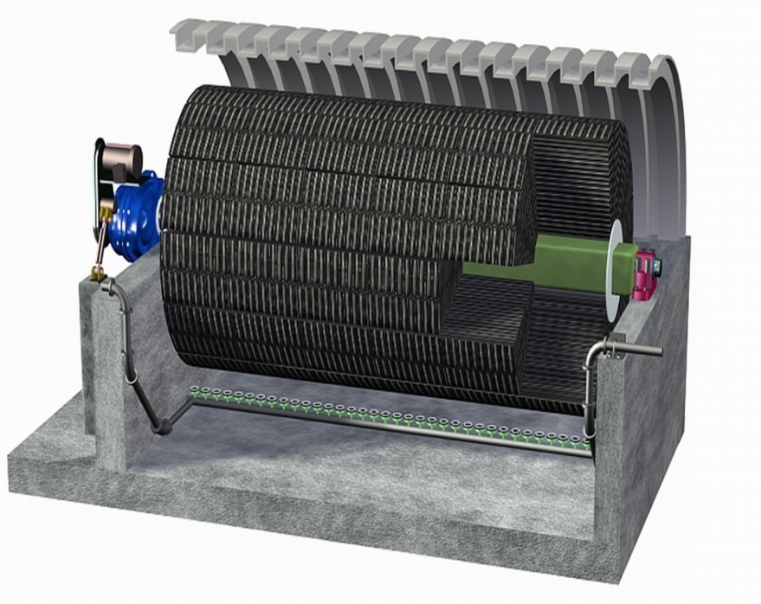
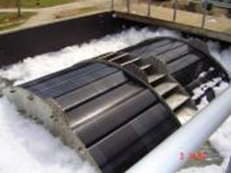
Rotating Biological Contactor
Series of disks several feet in diameter mounted on a shaft
The disks rotate slowly with their lower 40% submerged in wastewater
Rotation provides aeration and contact between the biofilm on the disks and the wastewater
The rotation causes the accumulated biofilm to slough off when it becomes too thick

Slide 20
Conventional Sewage Treatment
Processes
Secondary Treatment With Activated Sludge
Activated sludge-sewage mixture is called mixed liquor
Mixed liquor leaves aeration tank and flows to another sedimentation tank where suspended solids settle out for reuse as activated sludge

Slide 21
Conventional Sewage Treatment
Processes
Tertiary Treatment
Effluent is chlorinated (kills bacteria) and released into lake, ocean or river
Activated sludge in sedimentation tank is reused

Slide 22
Levels of Treatment
Primary
removal by physical separation of grit and large objects (material to landfill for disposal)
Secondary
aerobic microbiological process (sludge)
organic matter + O₂ → CO₂ + NH₃ + H₂O
NH₃ → NO₃⁻
lowers suspended solids content (into sludge)
Tertiary
Chlorination
Mostly dead microbes
aquatic nutrient

Slide 23
When the treatment is done…
Effluent back to stream after
a final carbon filtration and
chlorination/dechlorination
Sludge – very nutrient rich
applied directly to land as fertilizer
incinerated (good fuel after drying)
composted

Slide 24
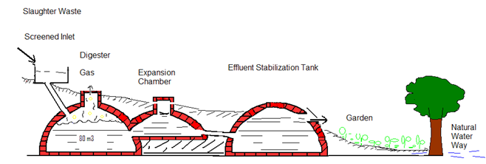

Slide 25
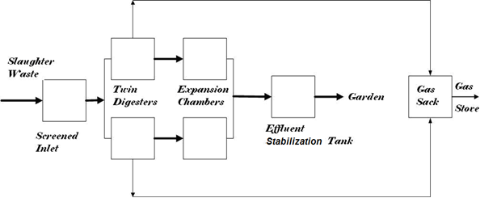

Slide 26
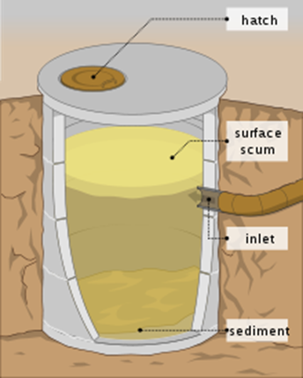
Septic tank
Areas of our country not connected to municipal sewerage systems are served by a SEPTIC TANK
Septic systems are a type of On-Site Sewage Facility
In affluent areas in Ghana, approximately 80% of the population relies on septic tanks
In Europe septic tanks are limited to rural areas only.
"septic" refers to the anaerobic bacterial environment that develops in the tank

Slide 27
Considerations
Aerobic
Anaerobic
Biochemical/Biological Oxygen Demand
Effluent
Scum
Sludge
Sewage
Depends on two kinds of bacteria:
Aerobic
Anaerobic

Slide 28
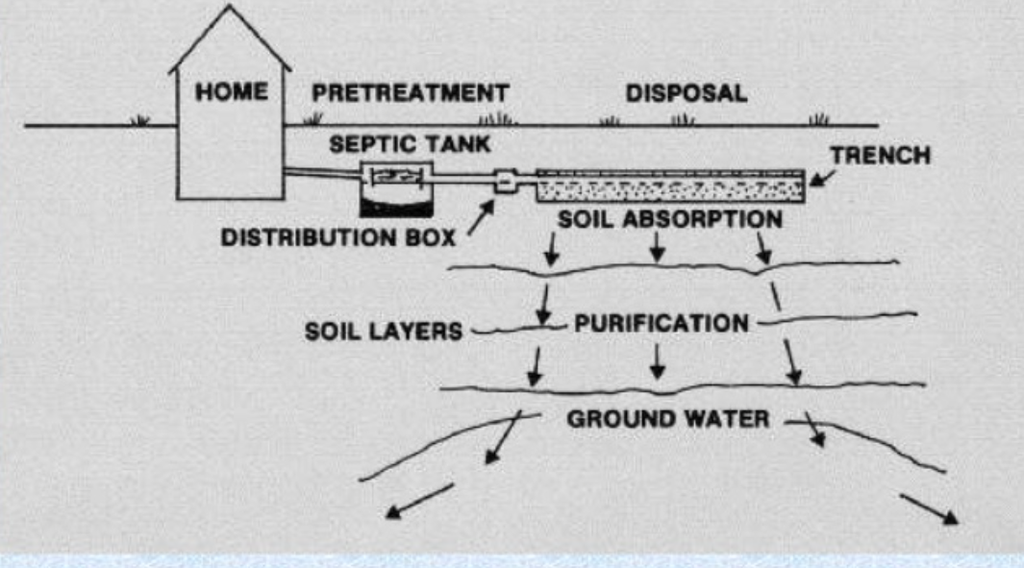
Treat sewage so that it is made harmless

Slide 29
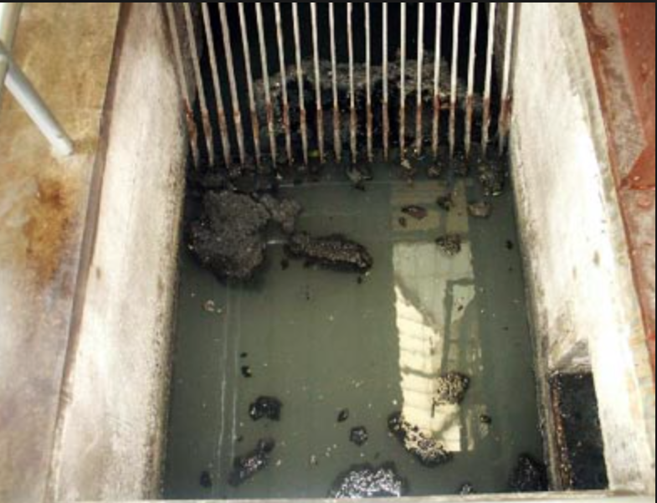
Primary treatment:
Separation of liquids and solids
Does not purify sewerage

Slide 30
In a Septic tank….....
Here sewage enters a holding tank and suspended solids settle out
Sludge is pumped out from time to time and disposed off – Lavenda Hill
Is mostly three chambers
Effluent flows through the perforations into leaching field and decomposed by microbes

Slide 31
Septic Tanks chamber
Sedimentation
Digestion tank
Storage of digested sludge

Slide 32
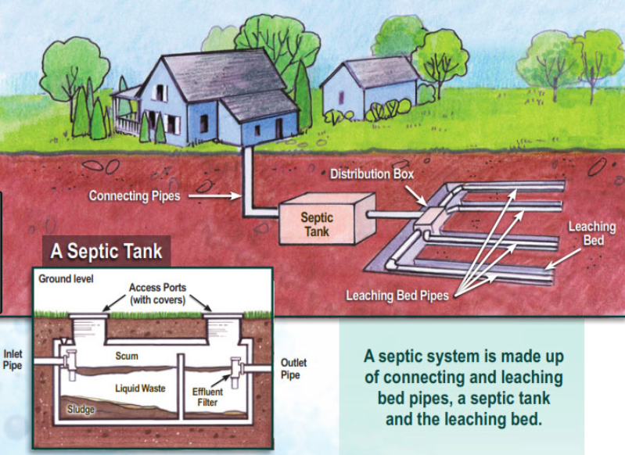

Slide 33
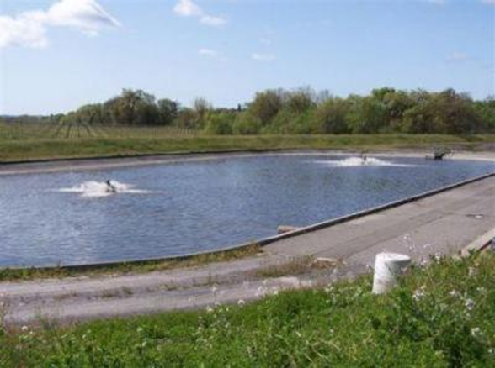
Oxidation ponds/lagoons/stabilization ponds
Inexpensive but requires large land
Its often in TWO stages
First stage like primary treatment
Here sludge settles out in the first stage
Second stage like secondary treatment
Here it is shallow enough to allow aeration by wave action and encourage aerobic conditions for bacterial growth

Slide 34
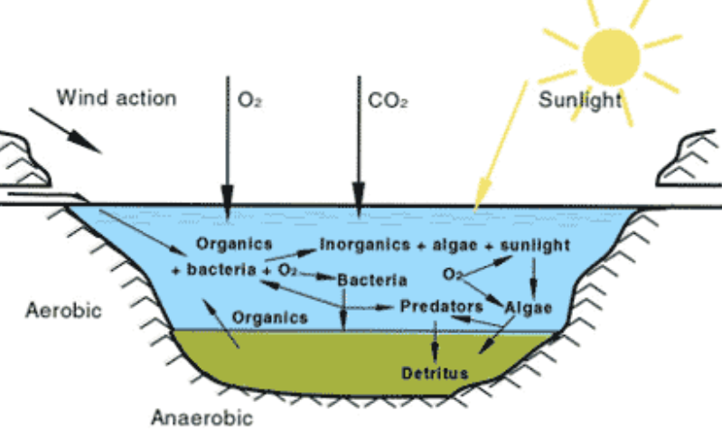
Oxidation ponds/lagoons/stabilization ponds
Encouraged decomposition of organic matter
Algae grows on top of the oxidation ponds,
Algae use carbon dioxide in photosynthesis to produce oxygen which promote the aerobic microbial activity

Slide 35
Most often treated sewage is disinfected by chlorination before discharge into receiving waters (Tertiary treatment)
Sometimes it can be treated to a level of purity that allows its use as drinking water
Here a combination of UV light and other disinfectants are employed

